Slide 1
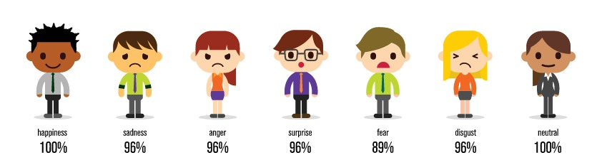
CLUSTER ANALYSIS LinkedIn Profiles

Slide 2
OUR TEAM
Kirandeep Kaur
Dr Monica Nguyen
Stats Wizard, Technical writing
Mentor
Harshad Subhash
Jaspreet Singh
Market Researcher,
Data Wrangler
Integrator, LinkedIn Enthusiast

Slide 3
TABLE OF CONTENTS
01
02
03
04
05
06
Introduction
Feature Analysis
Dimension Reduction
Cluster Analysis
Discovery & Inference
Recommendations

Slide 4

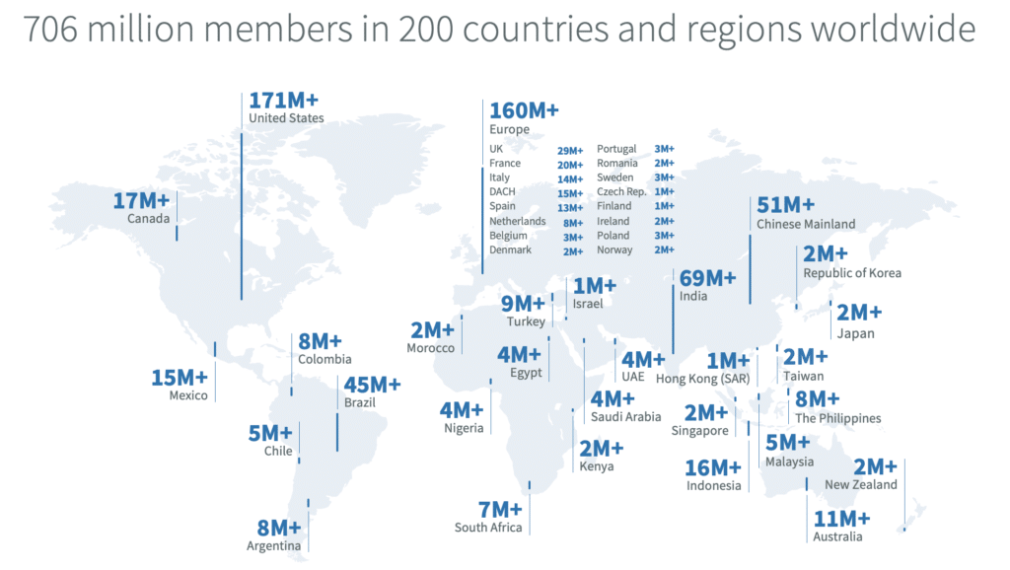

1. Introduction
Launched on May 5th 2003
Prominent social networking website for professionals
Acquired by Microsoft in 2016 for $26.2 billion, their biggest till date
1 million users by 2006, 706 million users as of May 2020
Goal:
Help students understand how to optimize a LinkedIn profile, by conducting cluster analysis and understanding the data more efficiently.
LinkedIn members with a photo receive far more engagement: 21 times more profile views and 9 times more connection requests.
Source: LinkedIn
Source: kinsta

Slide 5
2. Feature Analysis
Profile Data
Job Data
Profile Picture Analysis
Age
Image
Ethnicity
Nationality
Gender
No. of followers
No. of positions
Tenure length
Length of previous positions
Company name
Smile
Emotions
Blurriness
Picture quality
Face details
Skin details

Slide 6
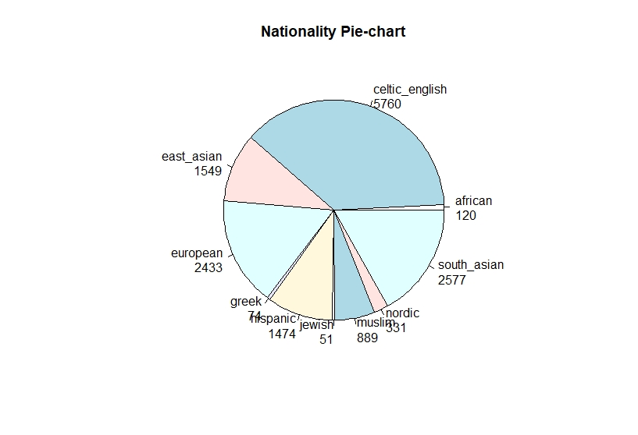
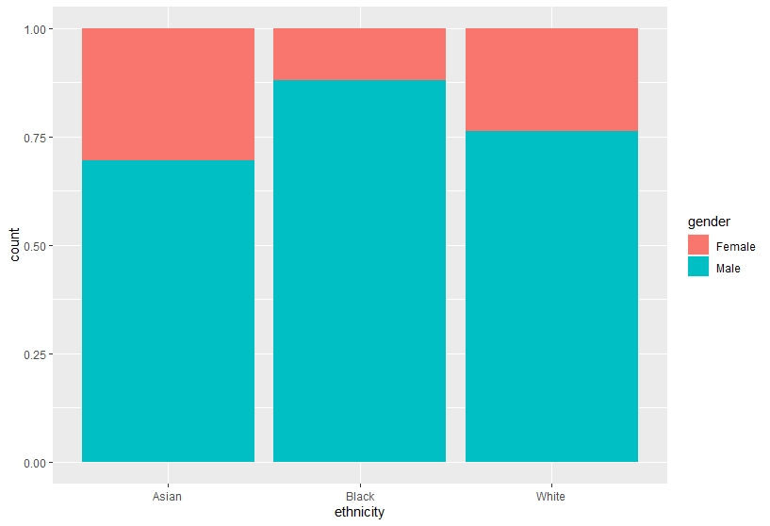
Demographic Info
Gender comparison based on ethnicity

Slide 7
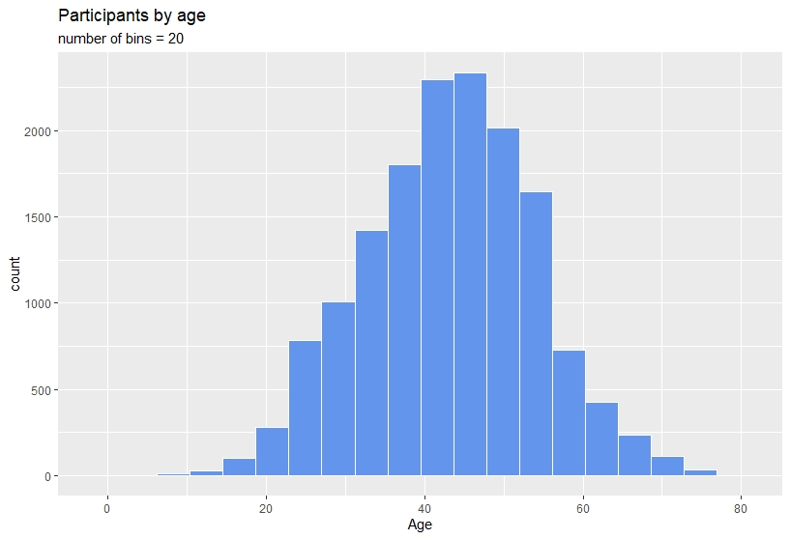
Age distribution
Range Count
13-22 497
23-32 2372
33-42 4829
43-52 5140
53-62 1919
63-73 450

Slide 8
Data Cleaning
Task | Dimension of data
Original data | 62,709 observations and 52 variables
Remove duplicate columns | 62,709 observations and 47 variables
Remove rows with average position length negative and age less than 13 | 62,623 observation and 47 variables
Extract numerical variables | 62,623 observations and 41 variables
Groupby data according to URN number as we had multiple observations for same URN number | 15,237 observations and 41 variables
Remove outliers with mahalanobis distance (Alpha = 0.01) and remove URN number variable as it is not significant for clustering | 10,610 observations and 40 variables

Slide 9
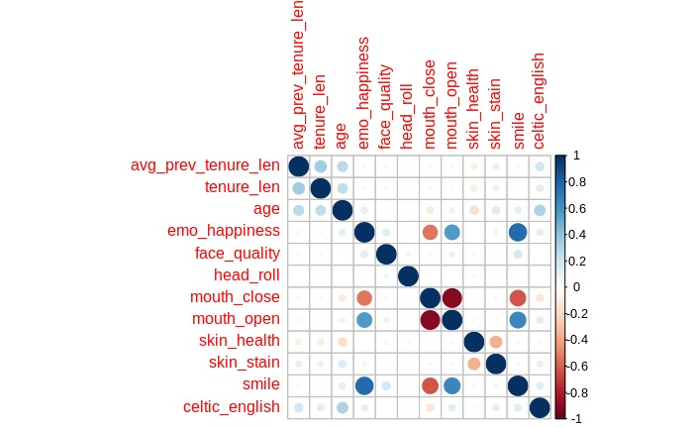
Dataset
Predominantly Australian profiles
62,709 observations and 52 columns
Data cleaning and preprocess requirements is performed on our dataset.
After processing our data, we have
10, 610 observations and 40 features
Notes:
Add a omplicated graph

Slide 10

3. Dimension Reduction

Slide 11
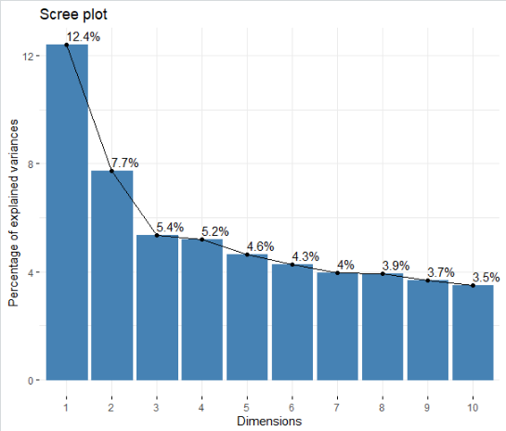
PCA
Principal Components
First 3 components are significant
Consistency
After 3th component, explained variance change becomes consistent
Variance
Components explain 25.49% variance

Slide 12
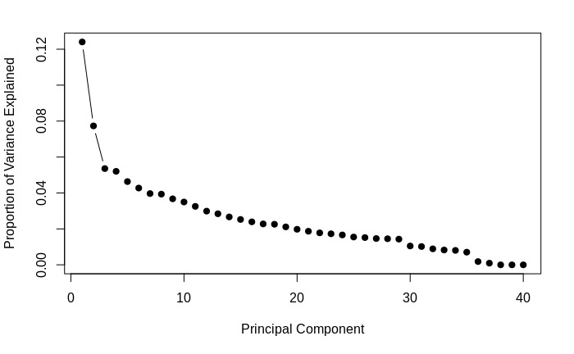
PCA
Elbow
Recognized at 3 principal component

Slide 13
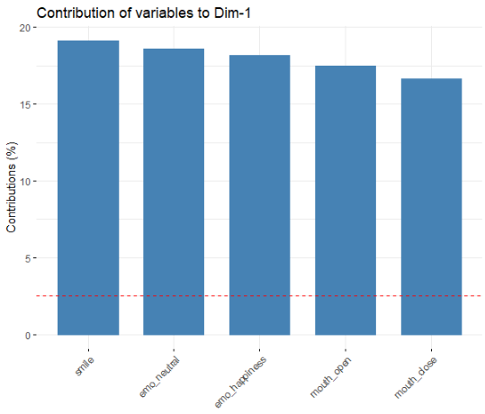
PC1 - Facial Expression

Slide 14
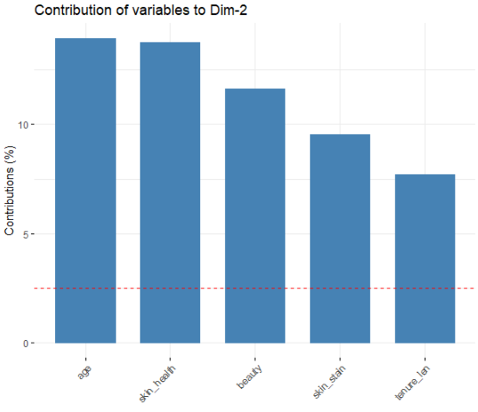
PC2 – Appearance

Slide 15
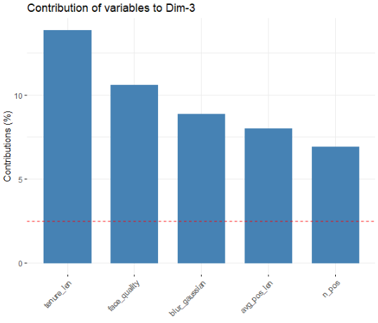
PC3 – Experience & Picture Quality

Slide 16
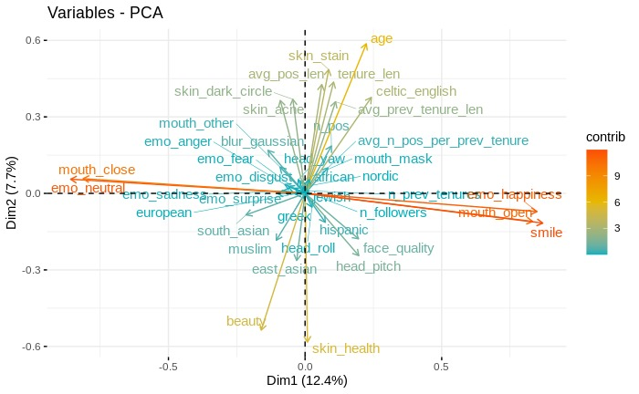
2D Visualization of PCs

Slide 17

3D Visualization of PCs

Slide 18
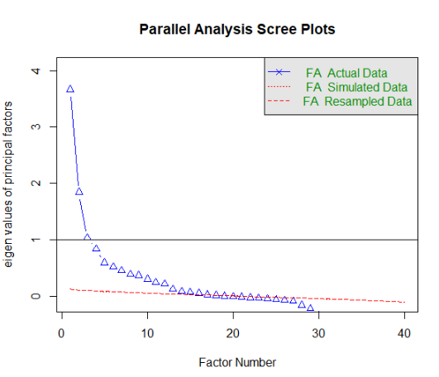
Factor Analysis
Latent Features
Parallel analysis leads us to 3 factors
EigenValue
Eigenvalue greater than 1 for first 3 factors
Notes:
Plots the eigenvalues of all factors. Sharp change suggests appropriate number of factors. The eigenvalues above 1 are good choice for selecting number of factors.

Slide 19

4. Cluster Analysis

Slide 20
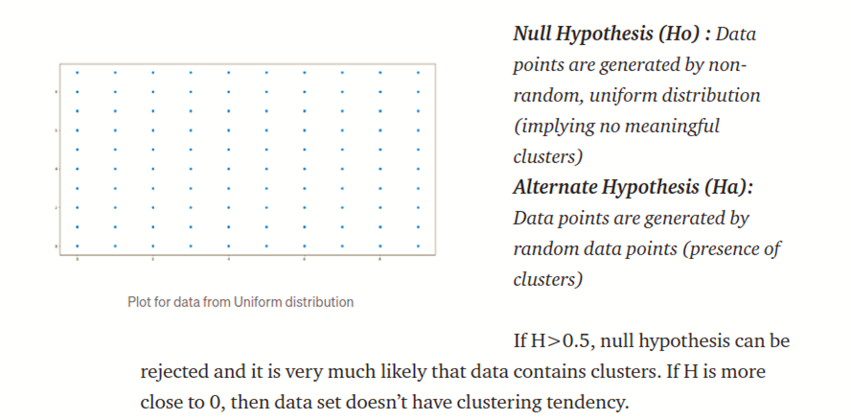
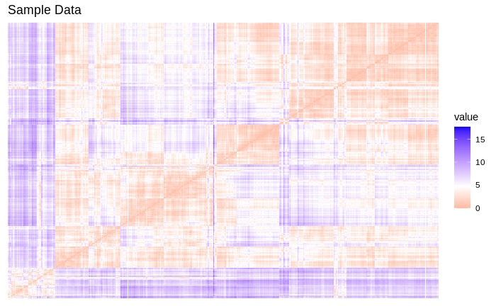
Hopkins Stats test
H = 0.9129644

Slide 21
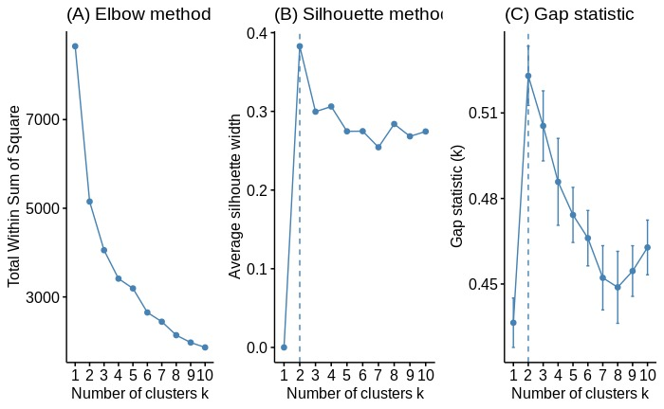
Partitioning Clustering

Slide 22
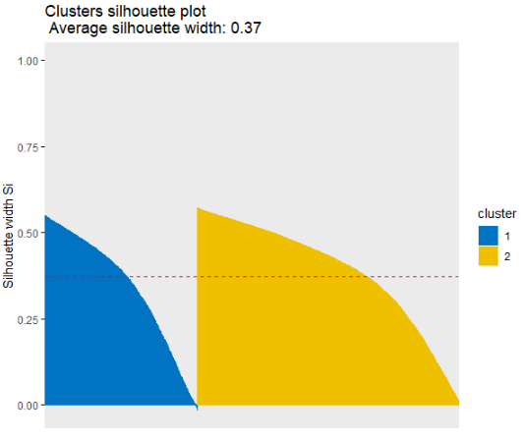
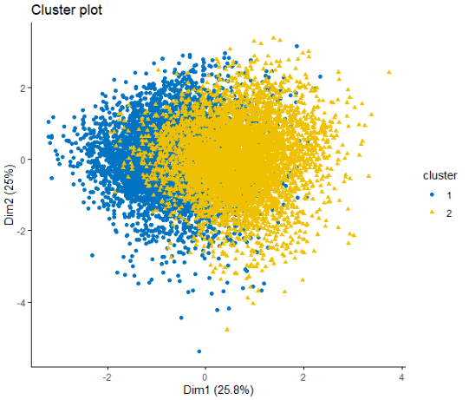
K-means

Slide 23
Hierarchical Clustering
Linkage methods | Coefficients
Single | 0.8952
Complete | 0.9734
Average | 0.9600
Ward | 0.9973
Ward linkage method is the best method for hierarchical clustering.

Slide 24
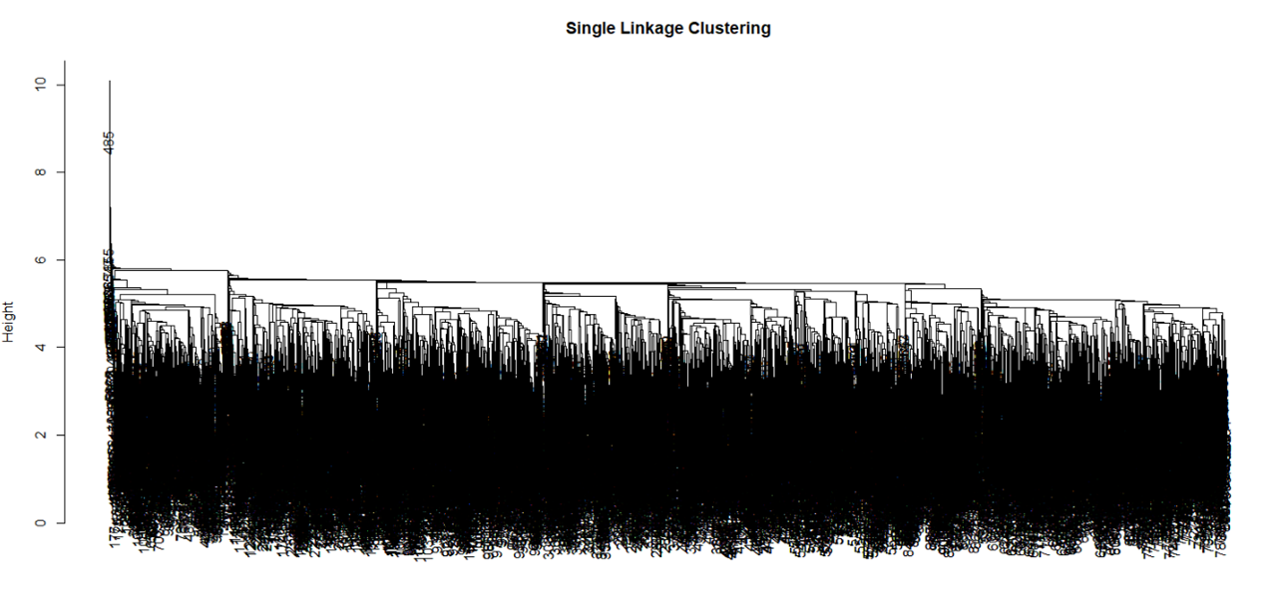
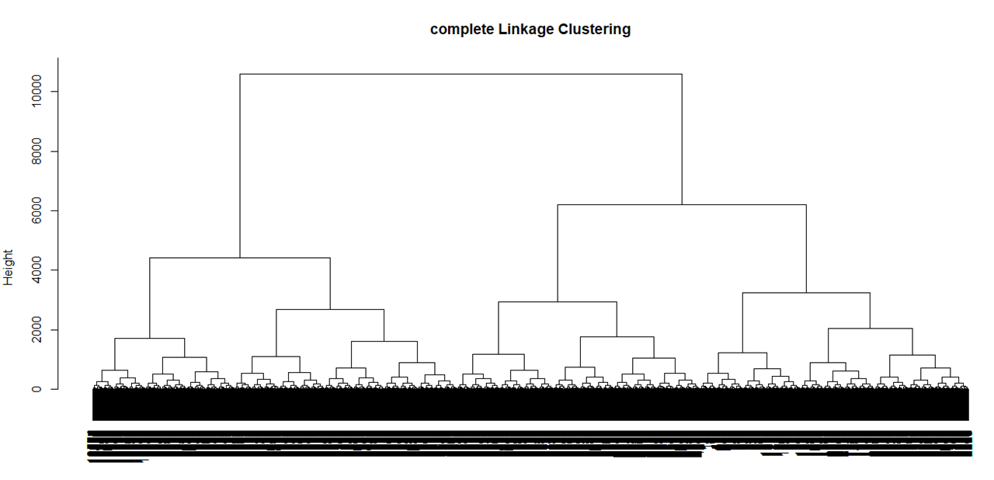
Hierarchical Clustering
Single Linkage Clustering
Complete linkage Clustering

Slide 25
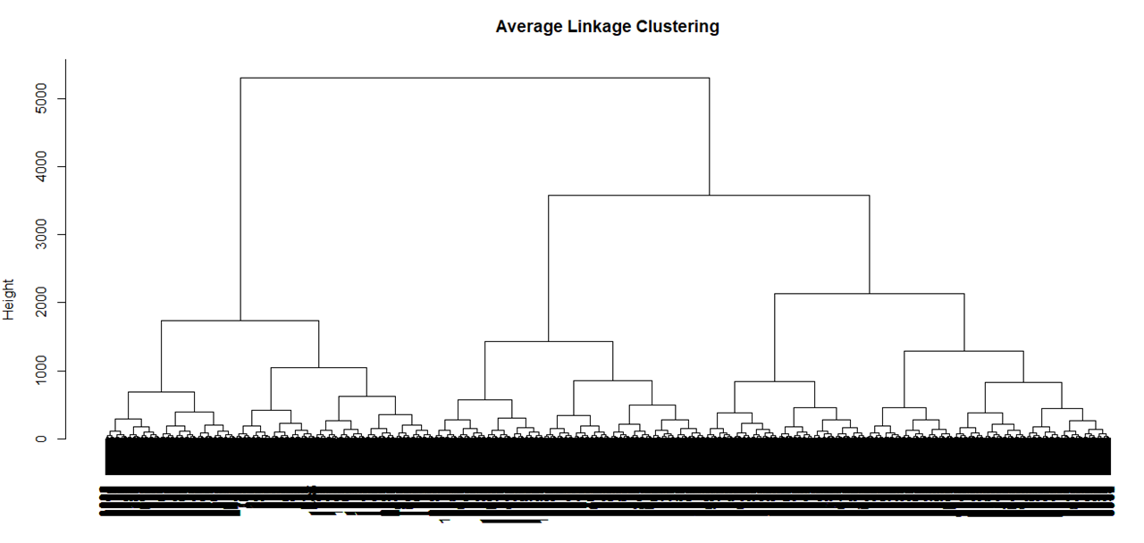
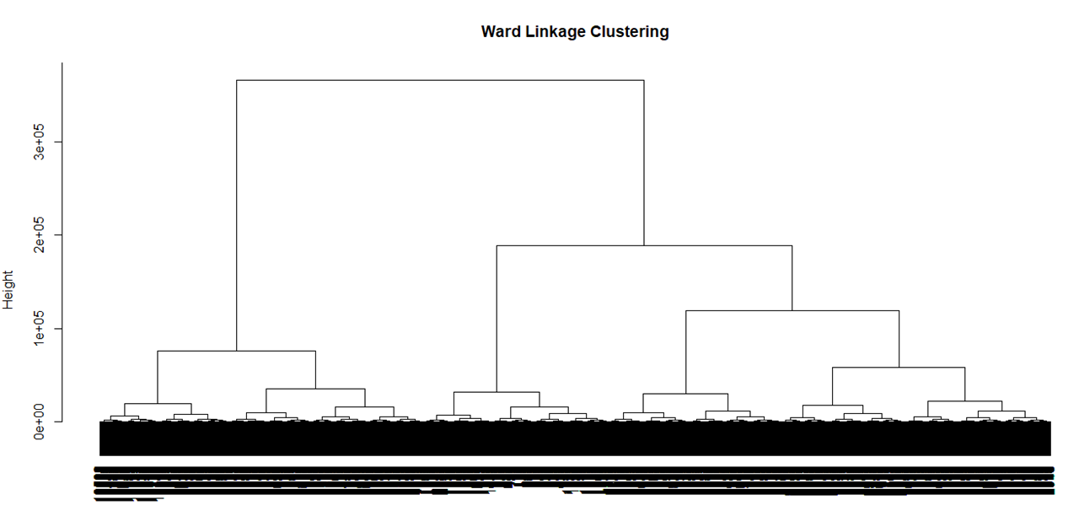
Hierarchical Clustering
Average Linkage Clustering
Ward linkage Clustering

Slide 26
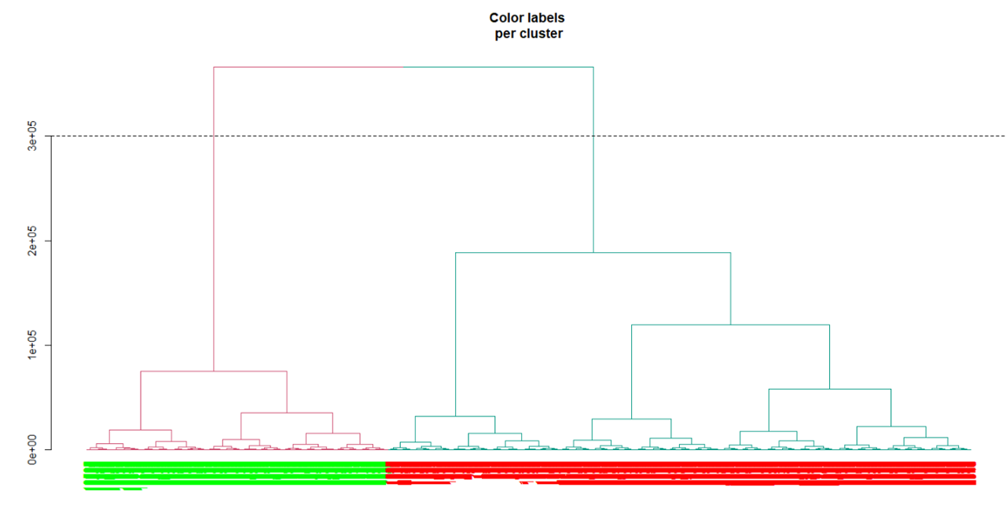
Ward Linkage Clustering

Slide 27
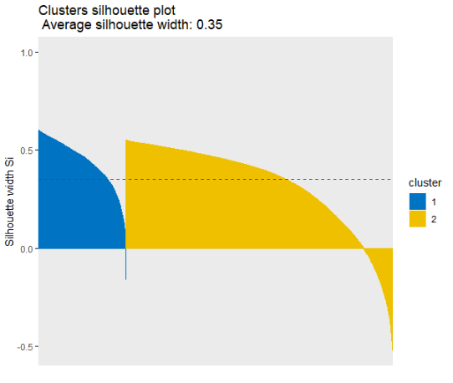
Silhouette Plot for Hierarchical Clustering

Slide 28
K-means v/s Hierarchical Clustering
Average Silhouette width
K-means | 0.37
Hierarchical clustering | 0.35
K-means and hclust has almost same average silhouette width. Hence, both techniques are equally significant/accurate for our dataset.

Slide 29
Validation
Clusters | 1st | 2nd
1st | 668 | 0
2nd | 110 | 283
Clusters from K-means and Hierarchical clustering shows accuracy of 0.8963
Accuracy | 0.8963
Sensitivity | 0.8506
Specificity | 1.0000
Model Comparison with different sample sizes: https://docs.google.com/spreadsheets/d/1KJ8q7cX0vXaIKItIwNQECMCirwZluSG8UmIuZ_tNpvg/edit?usp=sharing
Notes:
https://docs.google.com/spreadsheets/d/1KJ8q7cX0vXaIKItIwNQECMCirwZluSG8UmIuZ_tNpvg/edit?usp=sharing

Slide 30
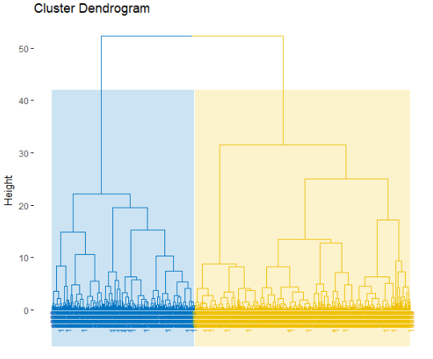
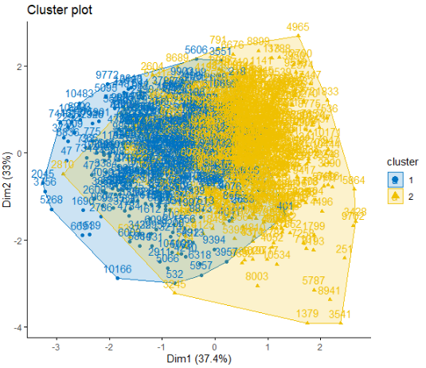
Advanced Clustering
Hierarchical k-means:
Compute hierarchical clustering and cut the tree into k-clusters
Compute the center of each cluster
Compute k-means by using the set of cluster centers as the initial cluster centers

Slide 31
5. Discovery
Asian people form majority of this cluster. They uploaded good quality pictures on LinkedIn and have good number of followers. Image analysis showed high score for beauty in their profile picture and seemed professional. The length of their previous positions is large which indicates loyalty; and it also means they were satisfied from their previous jobs.
Cluster1
This cluster is made up of individuals with a greater amount of experience. They are senior professionals with longer careers. One thing that surprised us is that they are not very concerned about their profile picture quality on LinkedIn as we found that their pictures are either blurred or we can notice deteriorating skin health from our analysis. This cluster mostly comprises of Celtic English.
Cluster2
Notes:
beauty,east asian,emo_disgust, emo_neutral, emo_surprise,face quality, mouth_close, n_followers, n_prev_tenures, skin health, south_asian are large
age, avg_n_pos_per_prev_tenure, avg_pos_len, avg_prev_tenure_len, blur_gaussian,celtic_english, emo_anger, emo_fear, emo_happiness, emo_sadness,skin_acne, skin_dark_circle, skin_stain, smile,tenure_len are large

Slide 32
6. Recommendations
Profile picture should be professional and try to smile in it
The picture should be clear, avoid blur
Networking is important, for higher engagement
Professional & Friendly profile picture builds your network quickly
Keep your profile updated, job history is significant.
Notes:
We will use analysis of variance for our Recommendations.

Slide 33
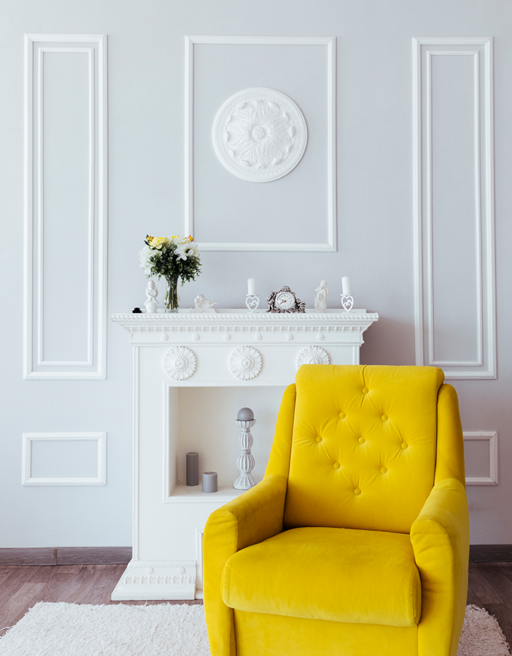
THANK YOU

